Slide 1
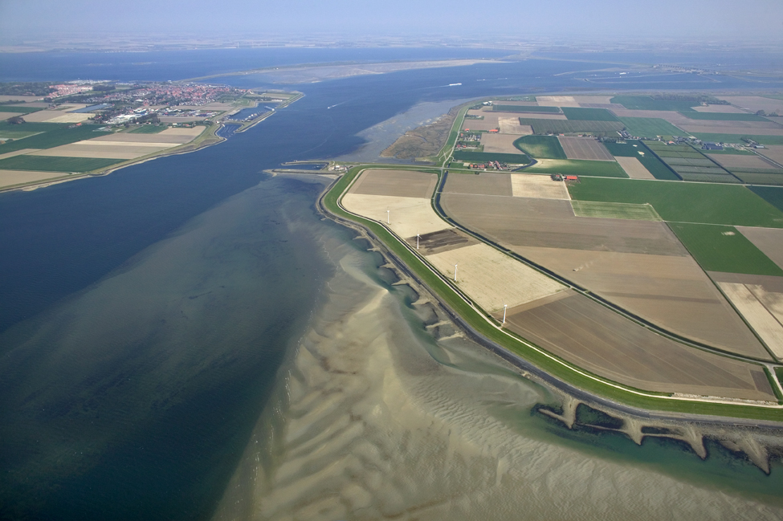


Thresholds

Slide 2
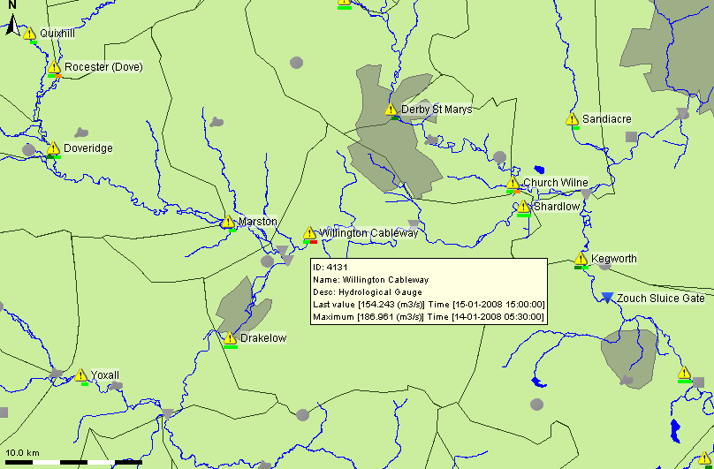
Example (Map)
Willington Cableway (Midlands, UK)
!
T0

Slide 3
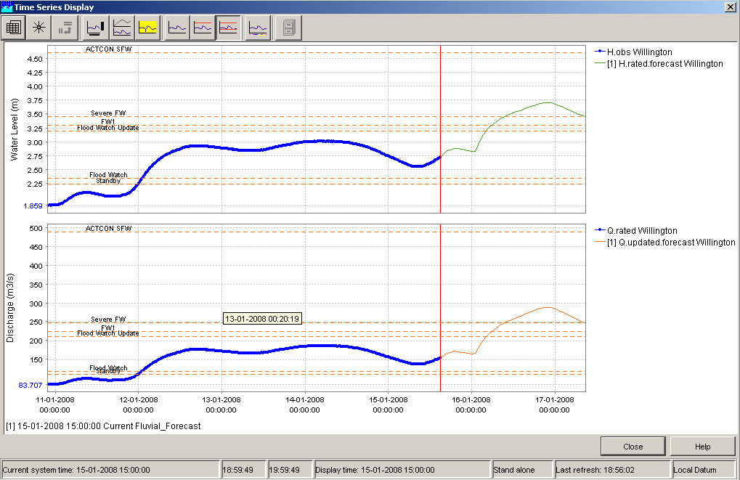
Example (Graph)
Willington Cableway (Midlands, UK)

Slide 4
Thresholds Utility
The thresholds utility checks when time series cross thresholds
Observed and simulated time series
Icons are shown on the map
Graphs/lines cross threshold lines
Events can be triggered (MC)
Up events and down events
Three configuration files
thresholdWarningLevels.xml → definition of (unique) thresholds + details
thresholds.xml → the grouping of the (selected) thresholds
thresholdValueSets.xml → timeseries (loc/par.) and actual levels info

Slide 5
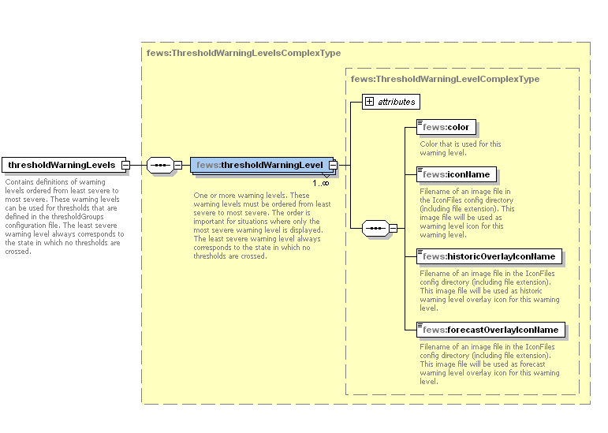
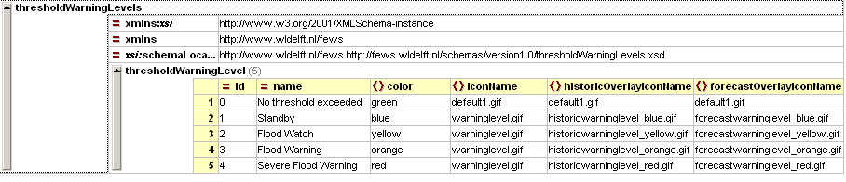
Thresholds - thresholdWarningLevels
Unique threshold information
colors: displays, reports
icons
normal/warning
historic colour
forecast colour
!

Slide 6
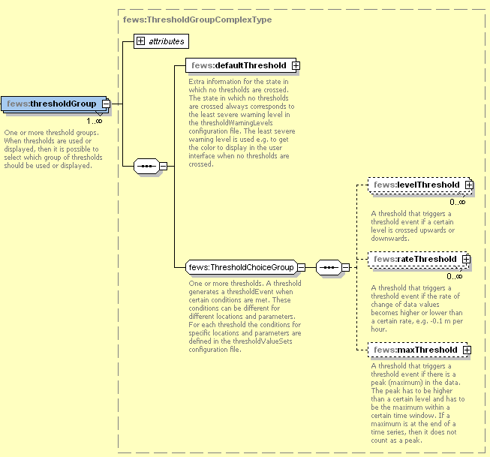
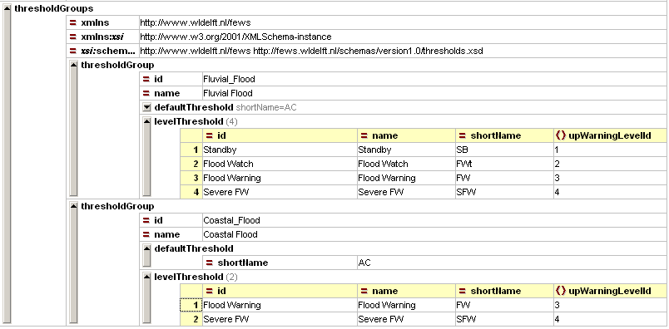
Thresholds - thresholds
Thresholds usage
groups
selection(s)

Slide 7
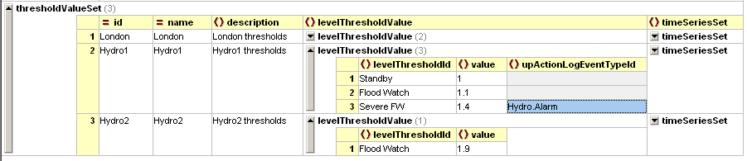
Thresholds - thresholdsValuesSets
Detailed threshold information
per location/parameter
actual values to be crossed for the different thresholds
‘triggers’ (action events for up- or downcrossings)

Slide 8
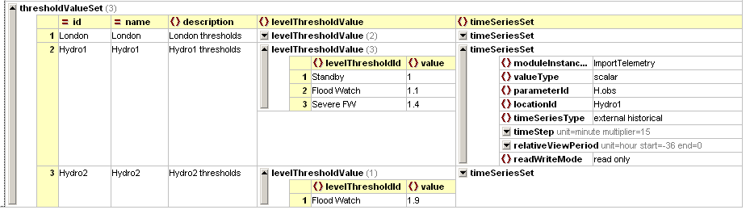
Exercise
Exercise 7: Change thresholds for imported data

